Slide 1

IBM CAPSTONE PROJECT
Jesna Salim
24-02-2026

Slide 2

OUTLINE
Executive Summary
Introduction
Methodology
Results
Visualization – Charts
Dashboard
Discussion
Findings & Implications
Conclusion
Appendix

Slide 3

EXECUTIVE SUMMARY
End-to-end Data Analytics project using real-world datasets.
Focus areas: data collection, preparation, analysis, and dashboard development.
Tools used: Python, SQL, Excel, Plotly, Dash.

Slide 4
EXECUTIVE SUMMARY
Data Collection
Retrieved job market data using APIs and HTTP requests.
Automated job count extraction by location and technology.
Stored structured datasets for analysis.
Sub Points
JSON parsing using Python
Reusable data collection functions
Export to Excel for reporting

Slide 5
EXECUTIVE SUMMARY
Data Understanding & Preparation
Explored large survey dataset (65k+ records, 100+ features).
Identified data types and handled missing values.
Prepared categorical variables for analysis.
Sub Points
Dataset structure validation
Data cleaning and preprocessing
Encoding categorical features

Slide 6
EXECUTIVE SUMMARY
Feature Engineering
Created derived metrics (normalized compensation, grouped categories).
Transformed variables for better analysis.
Prepared datasets for visualization and insights.

Slide 7
EXECUTIVE SUMMARY
Exploratory Data Analysis (Key Insights)
Salary varies significantly by developer role.
Geographic differences strongly impact compensation.
Experience and job satisfaction influence salary levels.
Sub Points
Outliers detected in salary distribution
Experience vs satisfaction relationship
Employment type salary differences

Slide 8
EXECUTIVE SUMMARY
Visualization & Dashboard
Built interactive dashboards using Plotly and Dash.
Compared trends across time periods (recession vs non-recession).
Visualized sales, advertising spend, and vehicle categories.
Sub Points
Line charts for trends
Bar charts for comparisons
Pie charts for category contribution

Slide 9

INTRODUCTION
Purpose of the Report
The purpose is to collect, prepare, analyze, and visualize real-world datasets to uncover meaningful insights related to developer job market trends and automobile sales performance.
The report demonstrates how data-driven analysis supports informed business and strategic decision-making.
Target Audience
Business stakeholders seeking insights for decision making.
Hiring managers and recruiters interested in job market trends.
Academic evaluators reviewing analytical methodology.
Data professionals and learners exploring applied analytics workflows.

Slide 10
INTRODUCTION
Value of the Analysisis
Market Understanding
Provides visibility into developer job demand, skills trends, and geographic distribution.
Compensation Insights
Identifies salary patterns across roles, experience levels, and employment types.
Business Performance Insights
Evaluates automobile sales trends and advertising impact across economic periods.

Slide 11
INTRODUCTION
Decision Support
Enables data-driven strategies for hiring, budgeting, and product positioning.
Sub Points
Supports strategic workforce planning.
Helps optimize marketing and advertising allocation.

Slide 12

METHODOLOGY
Data Sources
Developer survey dataset for demographic and compensation analysis.
Job posting API data to measure job demand by location and skills.
Automobile sales dataset for business trend analysis.
Supporting reference files for data enrichment.
Sub Points
CSV and JSON structured sources
Multi-source integration

Slide 13
METHODOLOGY
Data Collection
Retrieved API data using Python.
Imported datasets into pandas.
Automated job count extraction functions.
Stored datasets for reproducibility.
Sub Points
Programmatic extraction
Export to Excel

Slide 14
METHODOLOGY
Data Wrangling
Cleaned missing and inconsistent data.
Transformed data types and created features.
Encoded categorical variables.
Validated data quality.
Sub Points
Outlier handling
Prepared analysis-ready dataset

Slide 15

Results

Slide 16
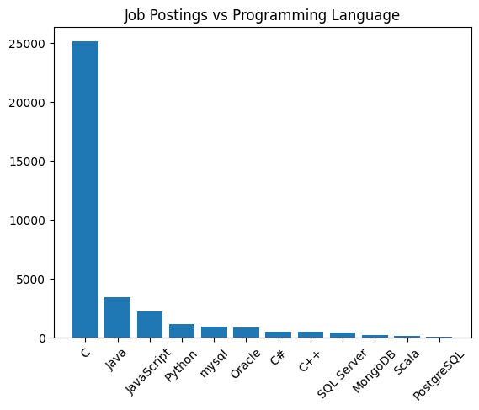
JOB POSTINGS

Slide 17
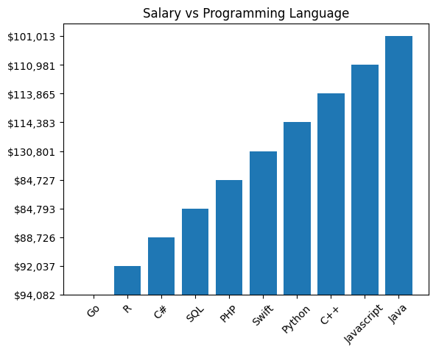
POPULAR LANGUAGES

Slide 18
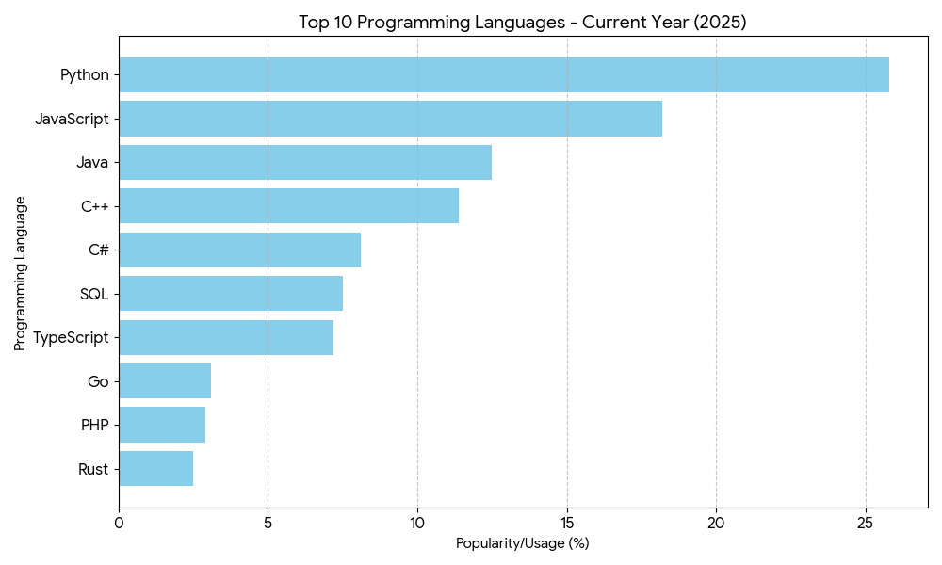
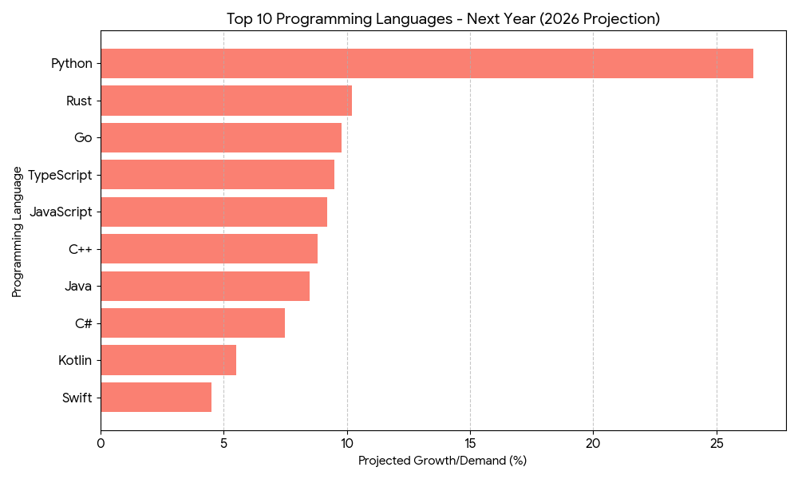
PROGRAMMING LANGUAGE TRENDS
Current Year
Next Year

Slide 19
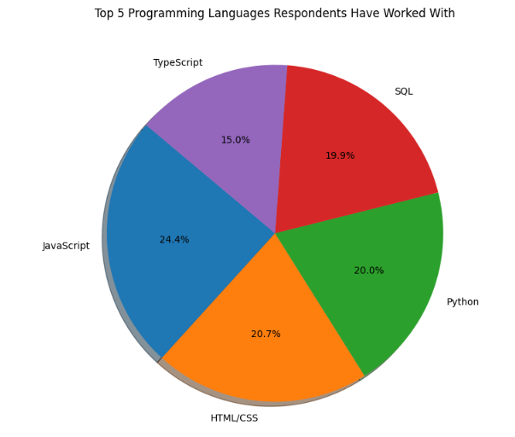
PROGRAMMING LANGUAGE TRENDS - FINDINGS & IMPLICATIONS

Slide 20
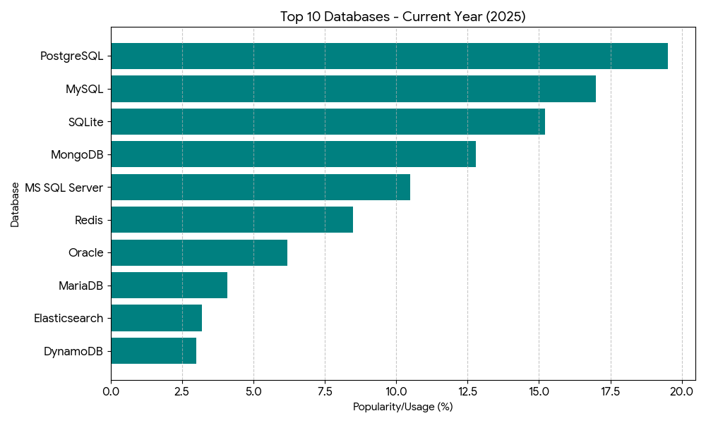
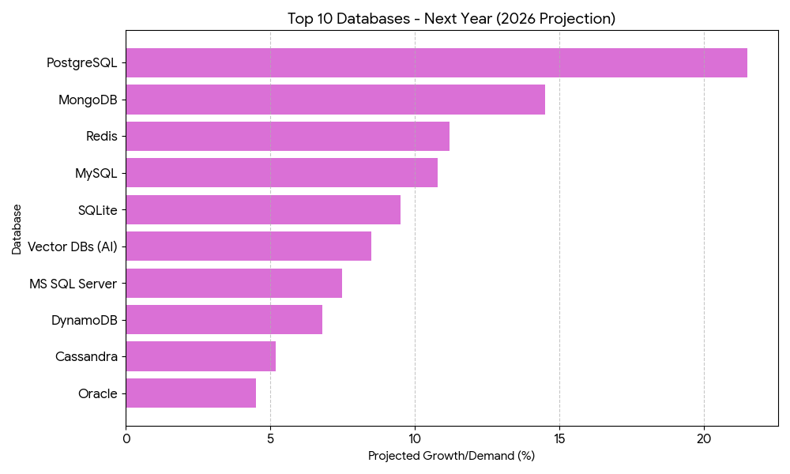
DATABASE TRENDS
Current Year
Next Year

Slide 21
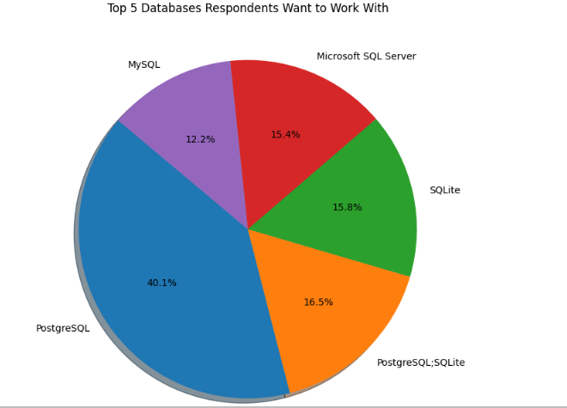
DATABASE TRENDS - FINDINGS & IMPLICATIONS

Slide 22

DASHBOARD

Slide 23
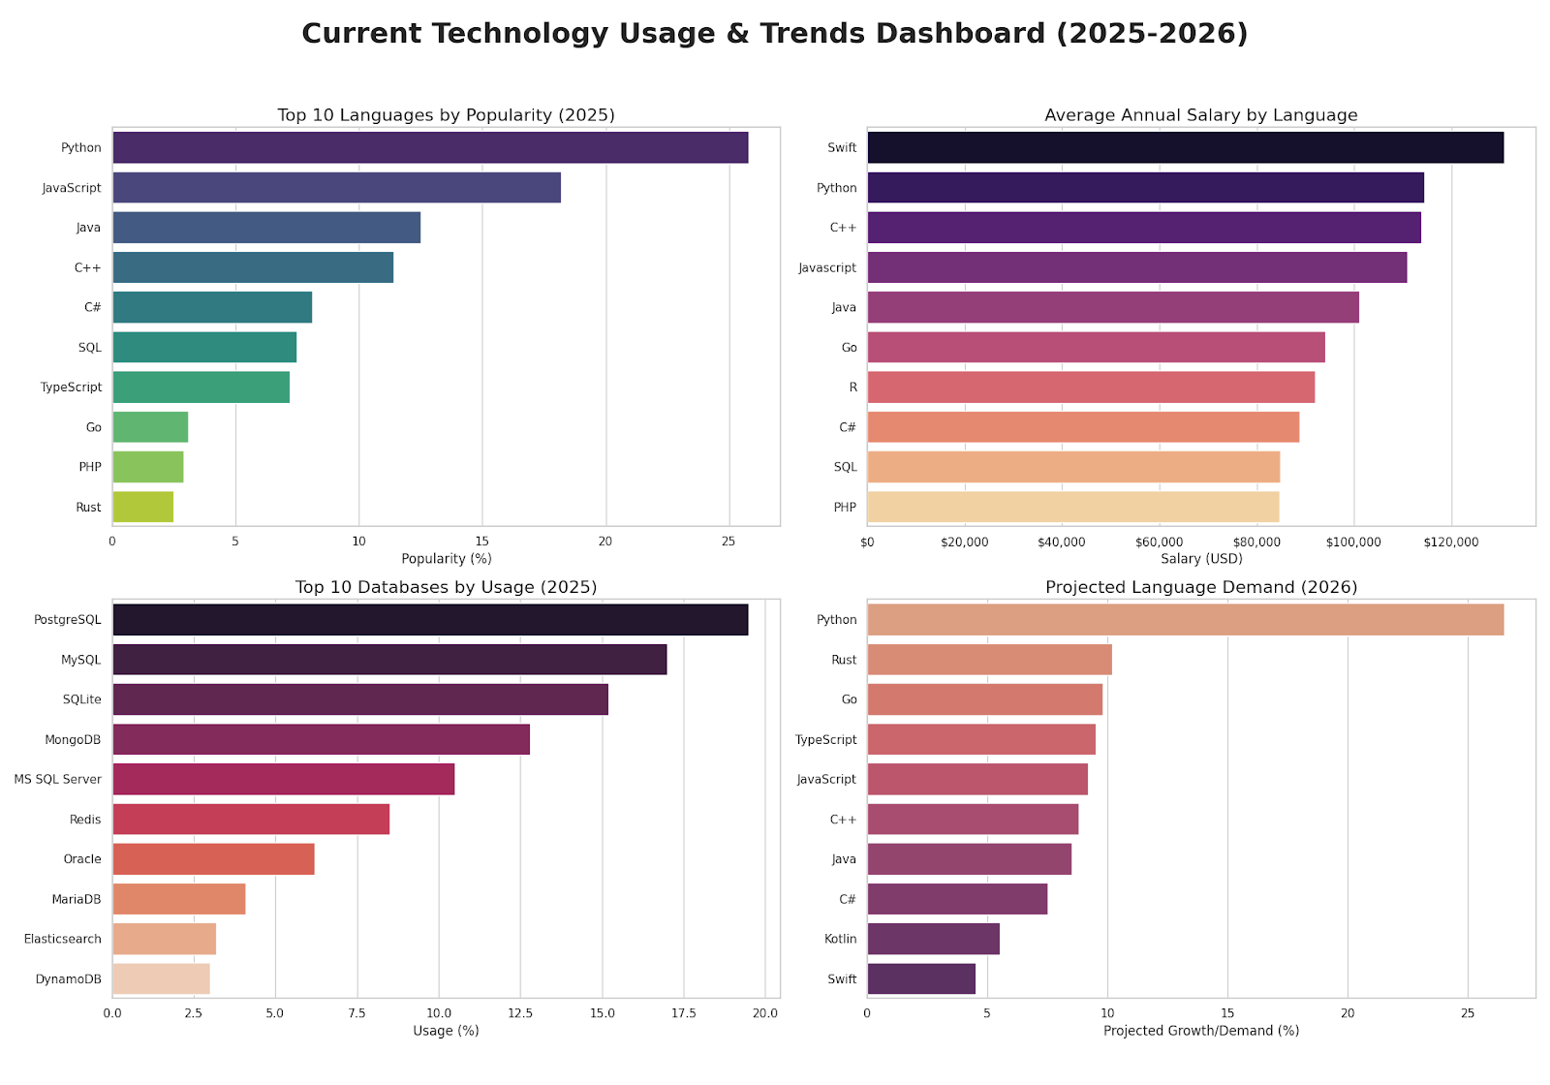
Current Technology Usage

Slide 24
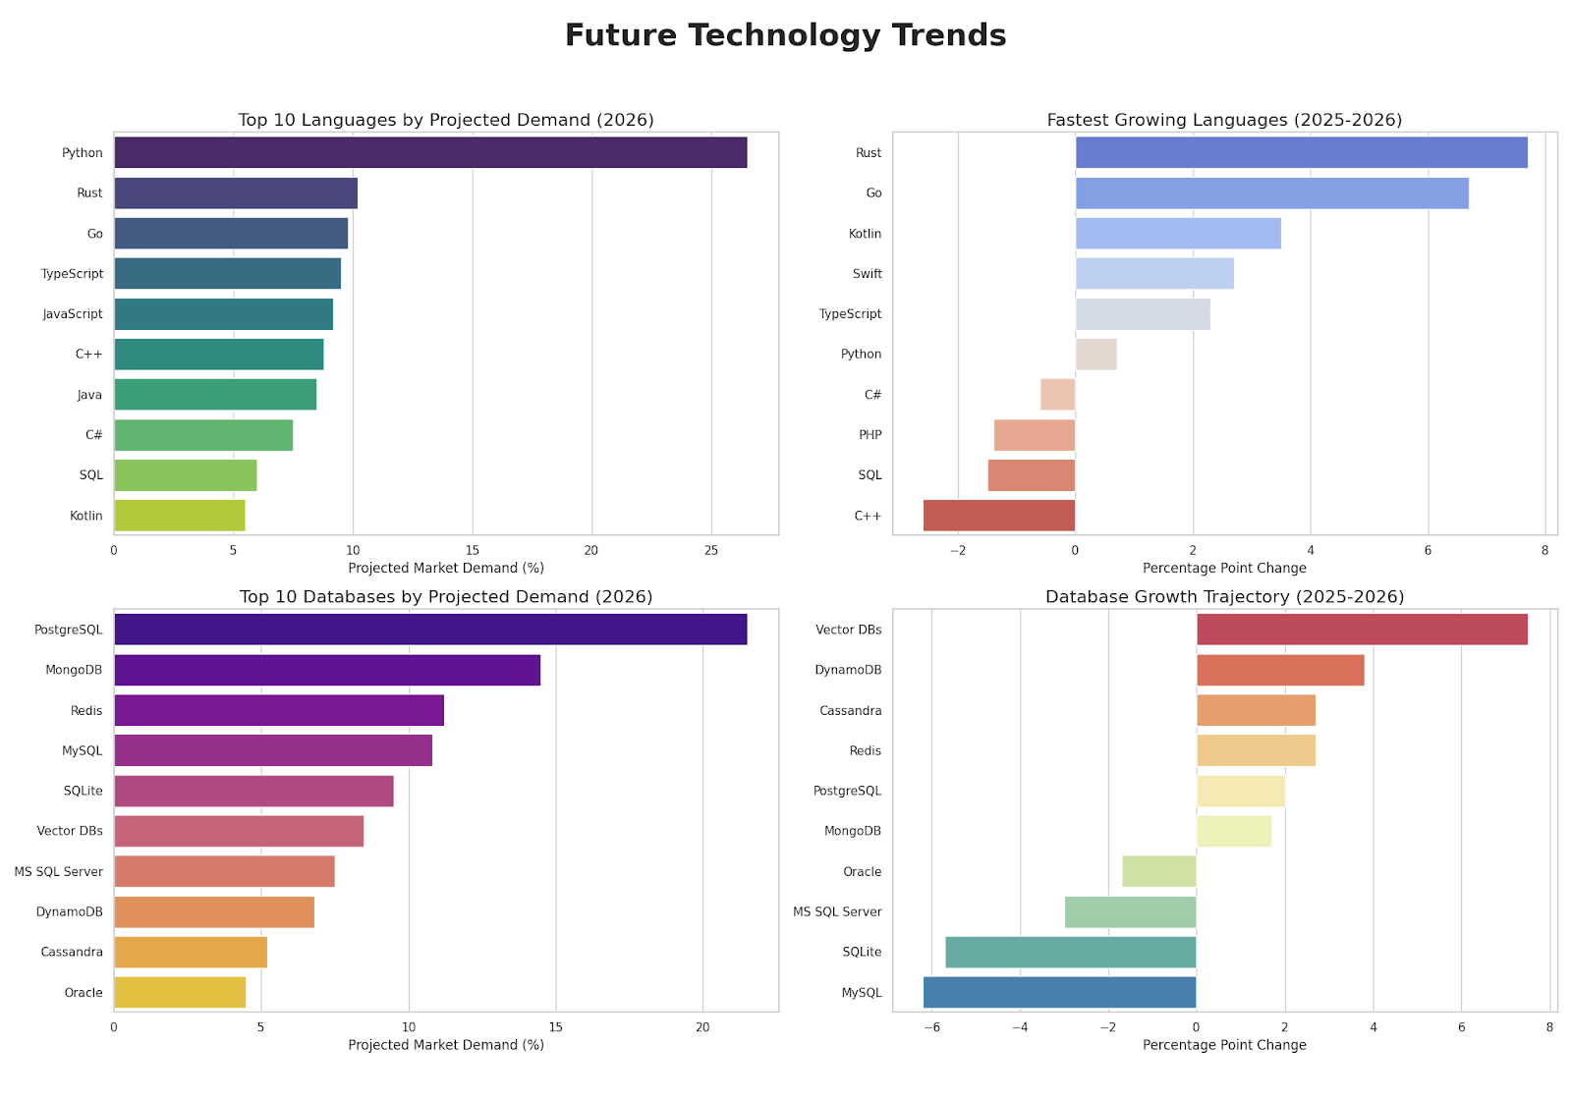
Future Technology Trends

Slide 25
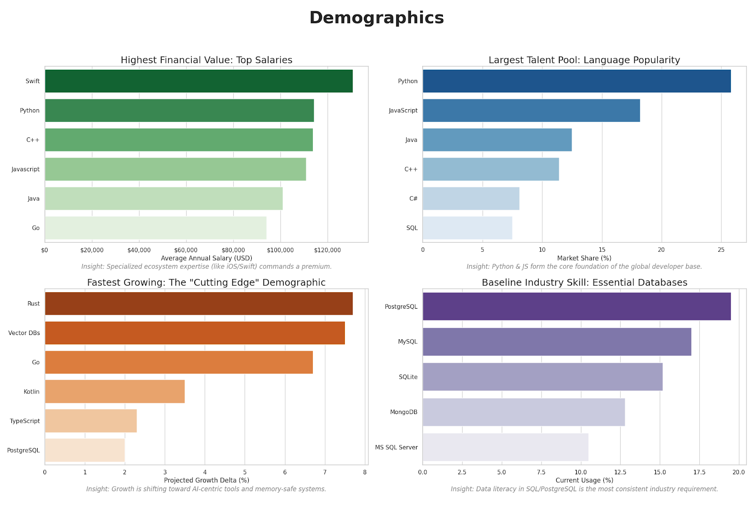
Demographics

Slide 26
Demographics
Metric | Leader / Peak | Insight
Highest Financial Value | Swift Developers | Specialized ecosystem expertise is highly rewarded.
Largest Talent Pool | Python & JavaScript | These languages form the "base" of the modern coding workforce.
Fastest Growing Skillset | Rust & Vector DBs | Represents the "cutting edge" demographic moving into AI and memory safety.
Baseline Industry Skill | SQL / PostgreSQL | Data literacy remains the most consistent requirement across all demographics.

Slide 27
DISCUSSION

Slide 28
OVERALL FINDINGS & IMPLICATIONS
Findings
Volume vs. Value Inversion: There is a significant disconnect between job availability and compensation. C and Java dominate the market in total job volume (over 28,000 combined postings), while the highest salaries are found in specialized languages like **Swift ($130,801)** and **Python ($114,383)**, which have far fewer postings.
The "Workhorse" Standard: Relational databases (**MySQL, Oracle**) and legacy languages (**C, Java**) remain the primary technical foundations of the industry. These "anchor" technologies provide the most consistent employment opportunities across the dataset.
Modern Stack Scarcity: Modern technologies like **PostgreSQL** and **MongoDB** show relatively low job volumes in current postings compared to legacy counterparts, suggesting they are either highly specialized or currently underrepresented in large-scale corporate hiring relative to their popularity in the developer community.
Implications
Specialization Premium: To maximize earning potential, professionals should transition from generalist roles to specialized ecosystems. The data implies that the "complexity premium" for AI (Python) and Mobile (Swift) allows for significantly higher salaries even in a more competitive or smaller job market.
Foundational Safety Net: For those prioritizing job security, maintaining proficiency in **C** and **Java** is essential. These languages serve as a professional safety net, ensuring a high volume of available roles even if they do not offer the absolute peak salary.
The Data Literacy Requirement: Database proficiency (SQL/Oracle) is not a standalone career path but a mandatory secondary skill. The consistent presence of these technologies across job postings implies that data management is a non-negotiable requirement for almost every high-level software engineering role.

Slide 29

CONCLUSION
Specialization Drives Compensation: While legacy languages offer the most jobs, niche expertise in Swift and Python yields the highest financial returns, with salaries peaking between $114k and $131k.
Stability in Legacy Systems: C and Java remain the industry’s functional backbone, providing a combined safety net of nearly 29,000 job postings for those prioritizing consistent employment.
The Persistence of Relational Data: Traditional databases like MySQL and Oracle continue to outperform modern NoSQL alternatives in job volume, cementing SQL proficiency as a mandatory "anchor skill."
Strategic Career Pathing: The data confirms a clear trade-off: professionals must choose between the high-volume security of established enterprise stacks or the high-salary potential of modern, specialized ecosystems.

Slide 30

APPENDIX
Financial Value: Swift and Python lead the market in individual earning potential, with Swift peaking at over $130,000.
Employment Stability: Legacy systems and enterprise standards like C and Java remain the largest sources of job volume, offering widespread security for developers.
Future Trajectory: Rust and Vector Databases are the primary growth drivers for 2026, signaling a shift toward high-performance systems and AI infrastructure.
Foundational Skills: PostgreSQL and MySQL continue to be the essential database standards, providing the necessary data literacy for modern development roles.

